Slide 1

C BYREGOWDA INSTITUTE OF TECHNOLOGY
A Presentation on Mini Project
Presented by:
RABIYA TABASSUM(1CK21AI029)
NOOR FATHIMA(1CK21AI026)
ASFIYA SAMREEN(1CK21AI004)
NIKHITA KR(1CK21AI025)
6th Sem, Dept of AIML.
Under the Guidance of:
ASHOK BABU A
Asst. professor,
Dept of AIML.

Slide 2

DEEPFAKE DETECTION USING MACHINE LEARNIING

Slide 3
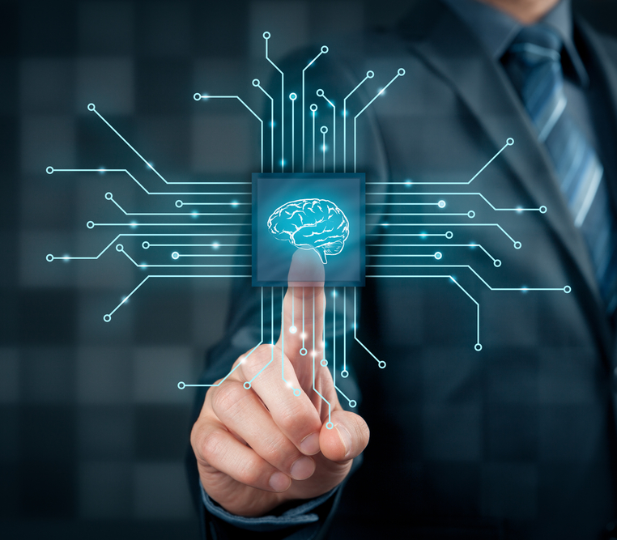
CONTENTS
Introduction
Software requirements & Indications
Design & implementation
Performance analysis
System testing
Results
Conclusion & future enhancement
references

Slide 4
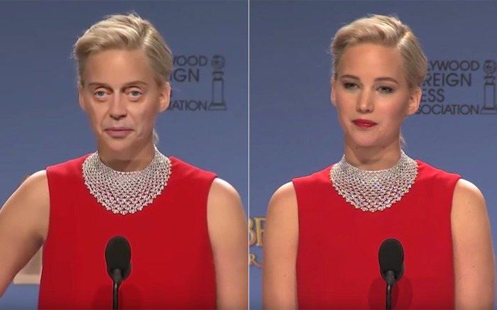
Introduction
Deepfakes are pictures altered to look other than their original state with the help of AI. Initial development of this technology served to fulfil the requirement of generating synthetic images in the entertainment sector, deepfake can provide realistic output. With more development in the field, happen the development of applications which allow people to use this face-swapping feature for humour purpose. Such applications were available for everyone to use and were not generating much authentic result. The same technology, when combined with deep learning turned out to be a massive outbreak.

Slide 5


SOFTWARE REQUIREMENTS & INDICATIONS
1. Programming Languages : Pyhton3 & JavaScript
2.Front end: PHP
3.Back end: MYSQL
4. Programming Frameworks : PyTorch & Django
5.Security measures: Data encryption & access control
6.IDE
Google
Jupyter Notebook
Visual Studio Code
7.Cloud Services : Google Cloud Platform

Slide 6
DESIGN:
The threat of deepfakes has prompted the development of strategies for identifying them. To recognize deepfakes, continuing techniques also applied innovatively-developed concepts and strategies to eliminate distinguishable and striking highlights. Location deepfakes are normally classified as binary classification problems, where classification logic is applied to distinguish images from altered ones.

Slide 7

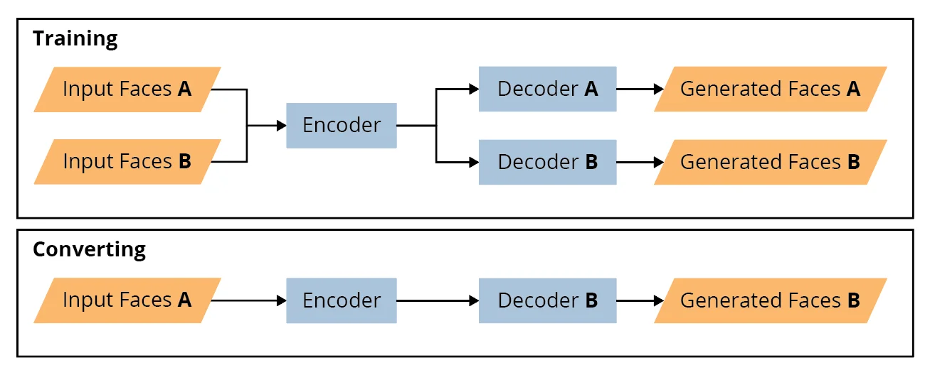
PERFORMANCE ANALYSIS

Slide 8
IMPLEMENTATION
from django.contrib import admin
from django.urls import path, include
from django.conf import settings
from django.conf.urls.static import static
urlpatterns = [
path('', include('ml_app.urls')),
] + static(settings.MEDIA_URL, document_root=settings.MEDIA_ROOT)

Slide 9
Continue……
import os
from django.core.asgi import get_asgi_application
os.environ.setdefault('DJANGO_SETTINGS_MODULE', 'project_settings.settings’)
application = get_asgi_application()

Slide 10
Continue……
import os
import sys
def main():
os.environ.setdefault('DJANGO_SETTINGS_MODULE', 'project_settings.settings')
try:
from django.core.management import execute_from_command_line
except ImportError as exc:
raise ImportError(
"Couldn't import Django. Are you sure it's installed and "
"available on your PYTHONPATH environment variable? Did you "
"forget to activate a virtual environment?"
) from exc
execute_from_command_line(sys.argv)
if __name__ == '__main__':
main()

Slide 11
System testing

Slide 12
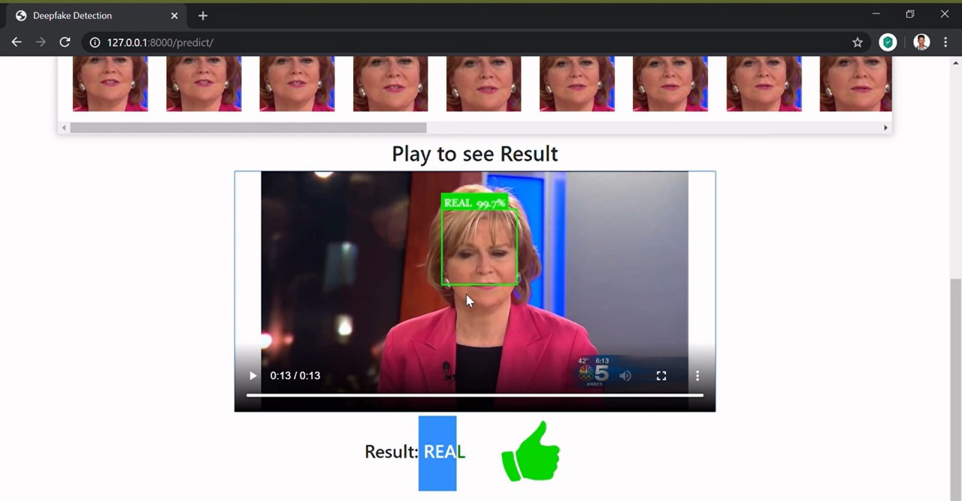
results

Slide 13
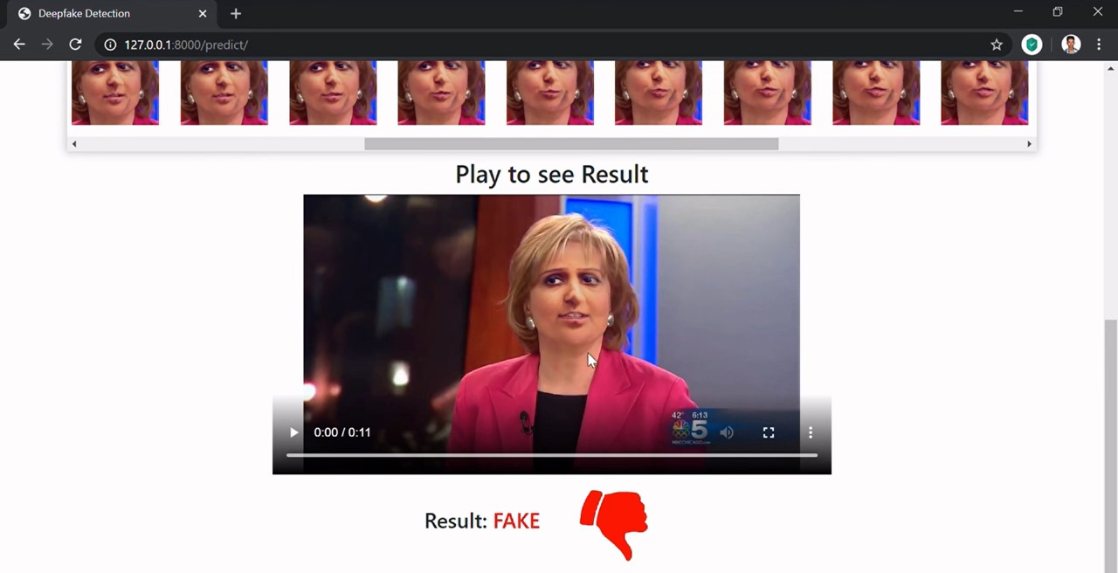
results

Slide 14
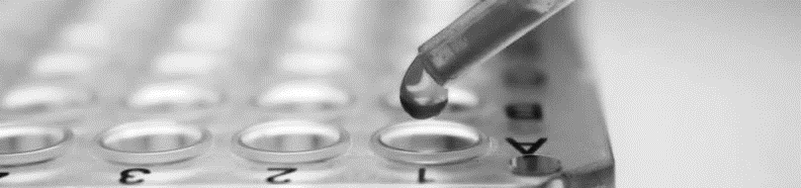
conclusion
This research is conducted to determine how well can the deep learning model developed over transfer learning perform in precisely distinguishing deepfake videos generated by AI from real video shot on camera. This model is comparatively better performing than other models in the area of image categorization. After the evaluation of the model, it can be concluded that deep learning model developed over a pre-trained model can very effectively determine deepfake videos from a real one and has much future scope.

Slide 15

FUTURE ENHANCEMENT
Detecting deepfakes is an ongoing challenge due to the rapid advancements in AI and deep learning techniques used to create them. Here are some potential future enhancements for deepfake detection:
Multi-model Analysis
Behavioral Analysis
Semantic Understanding
Blockchain & Authentication
Real – Time Detection System
Collaborative Efforts
User Education & Awareness

Slide 16

references
[1] Yuezun Li, Siwei Lyu, “ExposingDF Videos By Detecting Face Warping Artifacts,” in arXiv:1811.00656v3.
[2] Yuezun Li, Ming-Ching Chang and Siwei Lyu “Exposing AI Created Fake Videos by Detecting Eye Blinking” in arxiv.
[3] Huy H. Nguyen , Junichi Yamagishi, and Isao Echizen “ Using capsule networks to detect forged images and videos ”.
[4] Hyeongwoo Kim, Pablo Garrido, Ayush Tewari and Weipeng Xu “Deep Video Portraits” in arXiv:1901.02212v2.
[5] Umur Aybars Ciftci, ˙Ilke Demir, Lijun Yin “Detection of Synthetic Portrait Videos using Biological Signals” in arXiv:1901.02212v2.

Slide 17



Thank you

